Slide 1

Dr. Babasaheb Ambedkar Technical University MBES’s College of Engineering, Ambajogai
DEPARTMENT OF COMPUTER SCIENCE AND ENGINEERING
M.B.E.SOCIETY’S COLLEGE OF ENGINEERING, AMBAJOGAI 2022-2023

Slide 2
Presented By :
Aishwarya Karad (38)
Rutuja Bhosale (07)
Seema Kurhe (66)
Divya Aglave (73)
.
Internal Guide:
Prof.M.S. Sonwalkar
Guide In charge:
Prof. Vijay Chandode
PP
Prof. Sushil V. Kulkarni
(Head Of The Department)

Slide 3
Seminar on: MACHINE LEARNING BASED WORKLOAD PREDICTION USING CLOUD COMPUTING

Slide 4
CONTENTS :
Introduction
Literature survey
Objectives
Existing System
Proposed System
Data Flow Diagram
Software And Hardware Requirements
Advantages
Conclusion
References

Slide 5
INTRODUCTION
Cloud computing is a widely used IT service, which provides various services under one roof. Multiple types of services such as storage, computing and web hosting now can be provided by one cloud service provider.
Such elasticity of the service model brings about cost saving for most businesses by eliminating the need of developing, maintaining and scaling a large private infrastructure.

Slide 6
Literature Survey
As per article published in IEEE paper elaborating the idea of workload prediction of In this paper, it firstly measured and compared the state-of-the-art statistical and machine learning methods in the task workload prediction using the Google cluster trace.
This observation, together with the fact that complete application conﬁgurations on customers’ VMs are often unavailable to the cloud provider, motivated this study. Our approach is to ﬁrst develop a model to capture groups.

Slide 7
Literature Survey
Failure analysis in cloud data centers. Studied the impact of correlated failures on availability of distributed storage systems for Google clusters.
SVR has been investigated as an alternate technique for approximating complex engineering analyses.
Introduced a survey and taxonomy for resource orchestration in clouds while not focusing on adaptive resource management.

Slide 8
Objectives
Effective calculation of the workload in corresponding virtual machines.
To implement the different machine learning algorithms.
To enhance the overall performance for ML algorithm.

Slide 9
Existing System
As a widely used IT service, companies shift their services to cloud datacentres. It is important for CSP to provide cloud service resources with high elasticity and cost-effectiveness and then achieve good quality of service (QoS) for their clients.
However, meeting QoS with cost-effective resource is a challenging problem for CSPs because the workloads of Virtual Machines (VMs) experience variation over time.

Slide 10
Existing System
It is highly necessary to provide an accurate VMs workload prediction method for resource provisioning to efficiently manage cloud resources.
Comparing the performance of representative state-of the-art workload prediction methods

Slide 11
Proposed System
In proposed system, Work load dataset is implemented as input was taken from dataset repository.
The dataset was collected from github , it contains arrival time, burst time , resources and so on.
Then, the machine learning algorithms such as Random forest and SVM for classifying the tasks/work and allocated to VM’s properly, are to be implemented on the given dataset
The performance metrics such as accuracy, precision, recall and f1 score values, are calculated and the results are compared for both algorithm in the form of graph.

Slide 12


System Architecture
Handling missing values
Input data
Preprocessing
Label Encoding
Workload dataset
Drop unwanted columns
Data Splitting
Test
Classification
Train
SVM
Performance Metrics
RF
Accuracy, Precision
Task Allocated
Recall, F1 score

Slide 13
O/S : Windows 10. Language : Python Front End : Anaconda Navigator – Spyder Hardware Requirements System : Pentium IV 2.4 GHz Hard Disk : 200 GB Ram : 4GB
Software Requirements

Slide 14
Advantages
The final output will come-up with high efficiency.
It will avoid sparsity problems.
Reduces the information Loss and the bias of the inference due to the multiple estimates.
Inclusion of task allocation is proper.

Slide 15
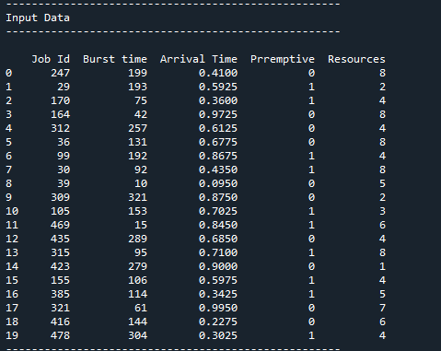
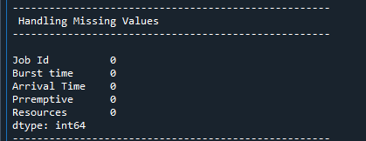
SCREENSHOTS:

Slide 16
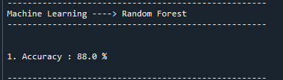
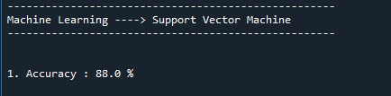
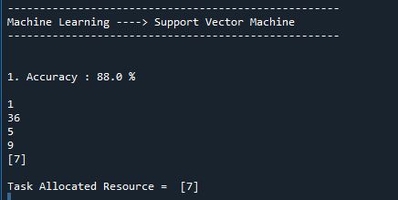

Slide 17
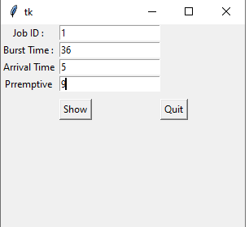
FINAL OUTPUT

Slide 18
Conclusion
Accurate task workload prediction is important in cloud resource management.
A clustering based workload prediction method for higher prediction accuracy.
This method clusters tasks with similar workload patterns, builds a workload prediction model for each cluster, and uses corresponding model to predict the upcoming workload of a task.

Slide 19
References
J. Gao, H. Wang, and H. Shen, “Task failure prediction in cloud data centers using deep learning,” Proc. of IEEE Bigdata, 2019.
A. Khan, X. Yan, S. Tao, and N. Aeurosis, “Workload characterization and prediction in the cloud: A multiple time series approach,” in Proc. of NOMS, 2012.
D. Basak, S. Pal, and D. Patranabis, “Support vector regression,” 2007. [41] “http://www.acheronanalytics.com/acheron-blog/how-to-measure-theaccuracy-of-predictive-models, [Accessed in APR 2019].”
M.Xu and R.Buyya, “Brownout approach for adaptive management of resources and applications in cloud computing systems: A taxonomy and future directions,” ACM Computing Surveys (CSUR), 2019.

Slide 20
Reference
Q. Zhang, L. Yang, Z. Yan, Z. Chen, and P. Li, “An efﬁcient deep learning model to predict cloud workload for industry informatics,” Trans. on TII, 2018.
W.Wei, H.Fan, X.and Song, and J.Fan, X.and Yang, “Imperfect information dynamic stackelberg game based resource allocation using hidden markov for cloud computing,” Trans. on SC, 2018.

Slide 21
THANK-YOU…

